Slide 1
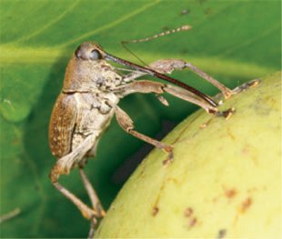
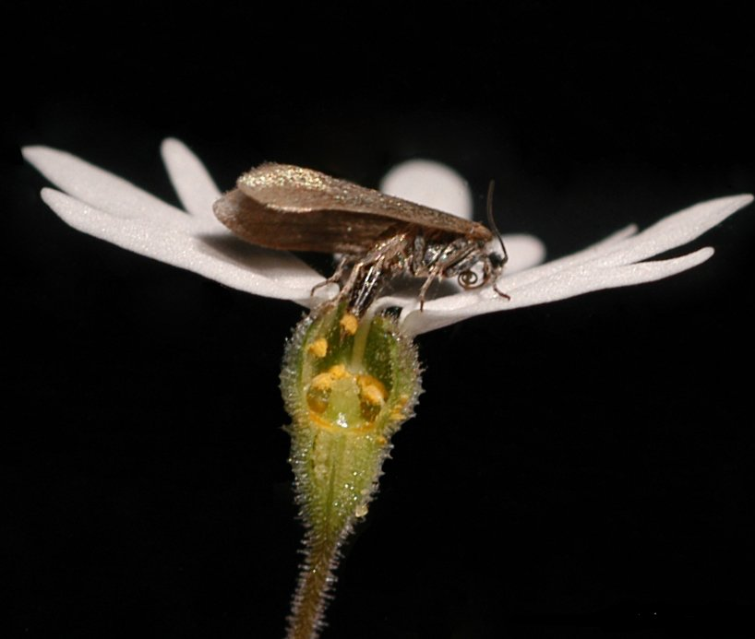
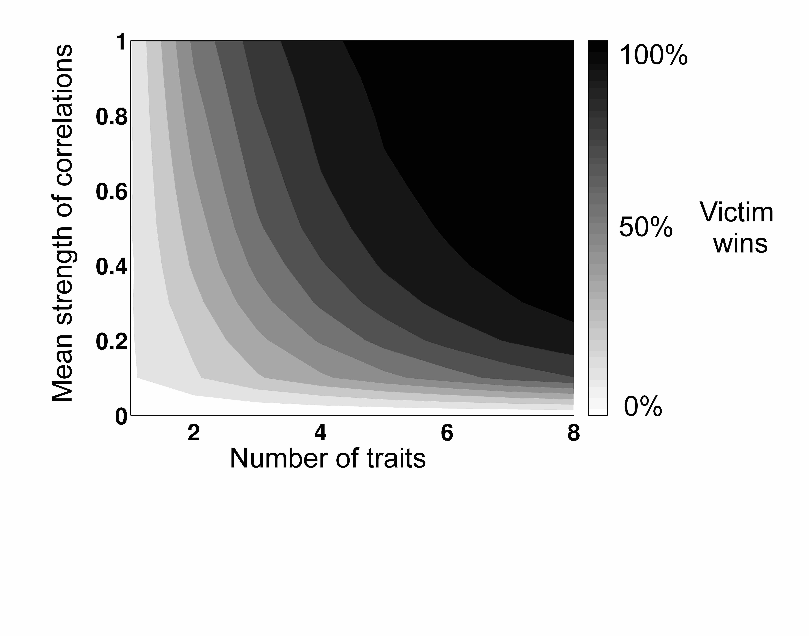
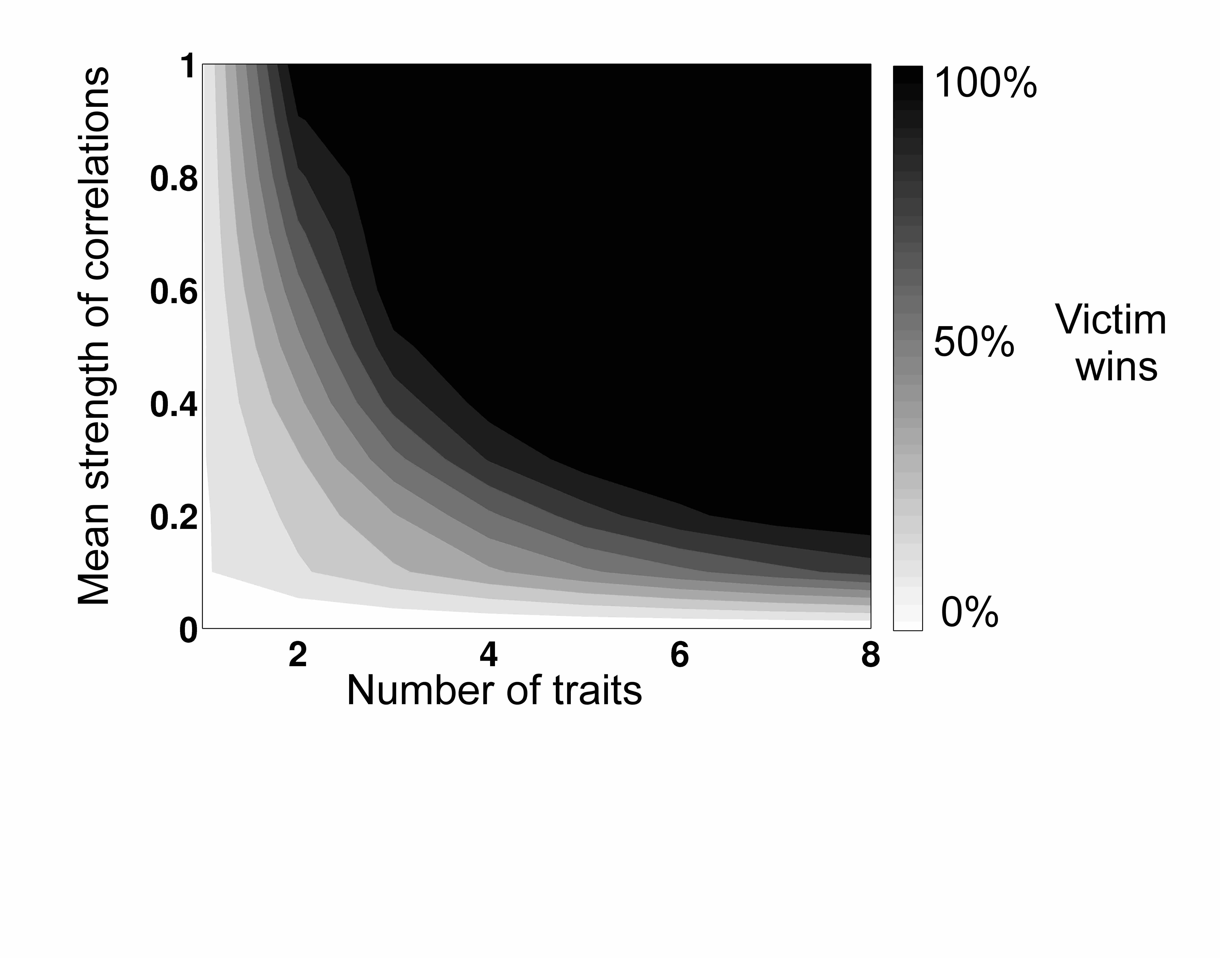
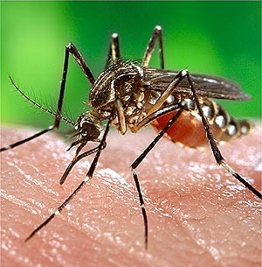
Coevolution in multidimensional trait space favors escape from pathogens and parasites
R. Tucker Gilman¹, Scott L. Nuismer², and Tony Jhwueng¹ ¹National Institute for Mathematical and Biological Synthesis (NIMBioS), Knoxville, Tennessee
²University of Idaho, Moscow, Idaho
Use sentence case in the title, all lowercase except first word.
Introduction
Virtually all species are subject to continuous attack by pathogens and parasites. Pathogens and parasites tend to have shorter generation times¹ and to experience stronger selection due to interaction than do their victims². Thus, it is frequently argued that they should evolve more rapidly, and so maintain an advantage in the evolutionary race between defense and counter-defense^{1,3}. This prediction generates an apparent paradox – how do victim species survive and even thrive in the face of a continuous onslaught of more rapidly evolving enemies³?
Here, we show that victim species can achieve an evolutionary advantage over their exploiters when species-species interaction rates are mediated by multiple traits in each species. This helps to level the playing field between victims and their exploiters. While our study is motivated by host-parasite interactions, our results are general to any victim-exploiter system. Thus, coevolution in highly dimensional trait space may help to explain why the world is green.
Results
Victim species are more likely to evolve low interaction rates with their exploiters when the number of traits that mediates the interaction rate is large and when correlations between those traits are strong.
Conclusions
Multiple traits and strong correlations between traits that govern species-species interactions favor victim species in evolutionary contests. Two mechanisms drive this effect:
Victims avoid exploitation if any one of their defense mechanisms overcomes the exploiter’s attack. Multiple traits offer victims multiple opportunities for evolutionary escape.
When the number of traits is large, G-matrices evolve to favor victim species (Tables 1 and 2).
In nature, correlations between traits are ubiquitous and often strong⁶. Such correlations may play an important role in the evolution of victim species in response to exploitation.
If you include a photo, add a thin gray or black border.
Figure 2. The pericarp thickness of the Japanese camellia and the rostrum length of its seed parasitic weevil Curculio camelliae comprise a difference trait pair.
Figure 4. The oviposition phenology of the seed parasitic moth Greya politella and the flowering phenology of its saxifrage host comprise a matching trait pair.
Difference traits
Matching traits
Literature cited
¹Hafner, M.S., Sudman, P.D., Villablanca, F.X., Spradling, T.A., Demastes, J.W., and S.A. Nadler. 1994. Disparate rates of molecular evolution in cospeciating hosts and parasites. Science 265(5175):1087-1090.
²King, K.C., Jokela, J., C.M. Lively. 2011. Trematode parasites infect or die in snail hosts. Biology Letters 7(2):265-268.
³Hamilton, W.D., Axelrod, R., R. Tanese. 1990. Sexual reproduction as an adaptation to resist parasites (a review). Proceedings of the National Academy of Sciences of the United States of America 87(9):3566-3573.
⁴Jones, A.G., Arnold, S.J., R. Burger. 2003. Stability of the G-matrix in a population experiencing pleiotropic mutation, stabilizing selection, and genetic drift. Evolution 57(8):1747-1760.
⁵Lande, R., S.J. Arnold. 1983. The measurement of selection on correlated characters. Evolution 37(6):1210-1226.
⁶Agrawal, A.F., and J.R. Stinchcombe. 2009. How much do genetic covariances alter the rate of adaptation. Proceedings of the Royal Society B 276:1183-1191.
Figure 1. Parasites often have shorter generation times and experience stronger selection due to interaction than do their hosts.
Methods
Most models of coevolution have focused on cases in which species-species interaction rates are governed by one trait in each species. Here, we allow species-species interactions to depend on multiple, potentially correlated traits.
We consider two types of traits. In difference traits, the interaction rate is maximized when the exploiter’s trait value exceeds that of the victim. In matching traits, the interaction rate is maximized when the exploiter’s trait value matches that of the victim.
We used numerical simulations⁴ and analytical models⁵ to investigate the conditions under which the victim species is most likely to evolve a low interaction rate with its exploiter, and thus to win the evolutionary contest.
Figure 3. In analytical models, the probability that a victim evolutionarily escapes from its exploiter increases with the number of traits and the strength of correlation between traits.
Figure 5. As in the difference trait case, the victim is more likely to escape from its exploiter when the number of traits is large and the correlation between traits is strong.
Number of traits | Expected magnitude of correlations due to pleiotropy in the absence of selection (r_{p})
 | r_{p}=1.00 | r_{p}=0.26 | r_{p}=0.08 | r_{p}=0.00
n=2 | 0.072 | -0.780 | -0.780 | -0.810
n=4 | 0.023 | -0.235 | -0.250 | -0.256
n=8 | 0.016 | -0.079 | -0.086 | -0.089
Number of traits | Expected magnitude of correlations due to pleiotropy in the absence of selection (r_{p})
 | r_{p}=1.00 | r_{p}=0.26 | r_{p}=0.08 | r_{p}=0.00
n=1 | - | - | - | 2.015
n=2 | 3.270 | 2.609 | 2.472 | 2.444
n=4 | 6.802 | 3.876 | 3.521 | 3.484
n=8 | 14.388 | 7.229 | 6.535 | 6.848
Table 1. Observed correlations between victim traits in numerical simulations. Selection due to species-species interactions generates negative correlations between victim traits. Negative correlations inhibit evolution, and reduce the chance of evolutionary escape. Negative correlations dissipate as the number of traits increases, relaxing constraints on evolution by the victim species.
Table 2. Genetic variance in victim traits relative to that in exploiter traits in numerical simulations. Species-species interactions generate disruptive selection on victim traits. This effect is strongest when the number of traits is large. Disruptive selection increases the genetic variance in victim traits relative to exploiter traits. Greater genetic variance allows victim species to evolve faster, and so to evolutionarily escape their exploiters.
For further information
Please contact rtgilman@nimbios.org. More information on this and related projects can be obtained at www.nimbios.org
Acknowledgments: This work was conducted with funding from the National Institute for Mathematical and Biological Synthesis, an Institute sponsored by the National Science Foundation, the U.S. Department of Homeland Security, and the U.S. Department of Agriculture through NSF Award #EF-0832858, with additional support from The University of Tennessee, Knoxville.
Notes:
Section Headers: Introduction (can include “Problem” and “Question”), Methods, Results, Conclusions, Literature Cited (approx. 10 citations max.). Each section should be a maximum of 200 words. Width of a text block: about 11 words per line. Height of a text block: no longer than 10 sentences.

