Slide 1
Math/EEB 589 - Mathematics of Machine Learning Methods in Ecology and Environmental Science Unsupervised Learning Methods: Dimension Reduction and PCA
The objective of dimension reduction is to provide a means to simplify a multivariate data set allowing you to visualize the structure of the data set to uncover interesting patterns. So in general these include methods to develop an efficient representation of a multidimensional dataset by moving it to 2 or 3-dimensional space. These methods do not involve a training set but focus on simplifying a complex dataset.
Principal component analysis (PCA) is one of a set of projection methods that choose one or more linear combination of the measurement variables to maximize some metric of how “interesting” the result is. PCA reduces the number of variables while retaining the variation in the data.

Slide 2
Unsupervised Learning Methods: Dimension Reduction and PCA
There is a long history of ordination in ecology, which “orders” multivariate data. Classic examples are using environmental data such as topographic data (slope, aspect, elevation) in conjunction with environmental variates (temperature, precipitation, soil type, etc.) to classify the abundance distribution of species. It is a classic method in community ecology in which the variables are the abundances of different species populations and determine the patterns of relationships between the species in a community. Ordination is used to explore the field data to generate hypotheses about community structure and function and how these vary across environmental gradients.

Slide 3
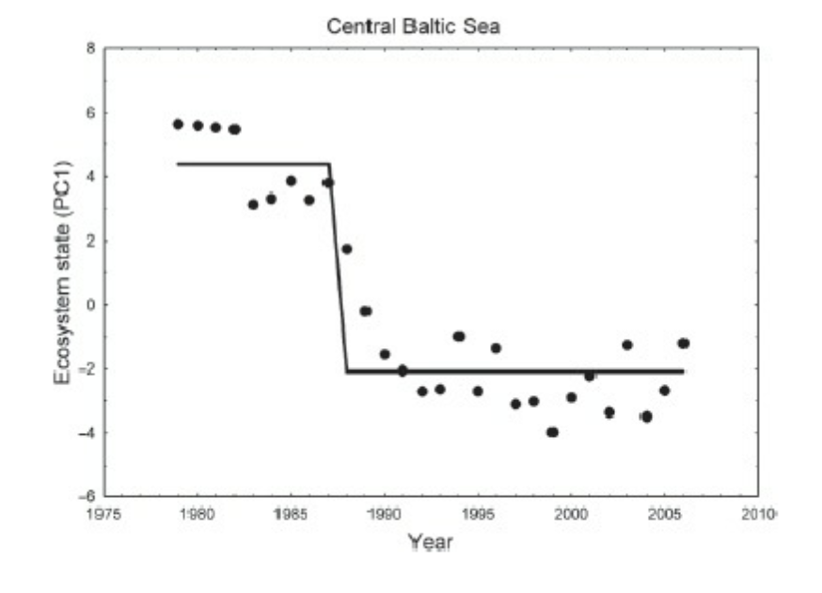
Unsupervised Learning Methods: Dimension Reduction and PCA
A more recent example of the application of these methods is to identify regime shifts (large, abrupt and persistent changes in the structure of an ecosystem) based upon temporal sets of complex data .
R. Biggs et al., 2012. Regime Shifts. Encyclopedia of Theoretical Ecology

Slide 4
Unsupervised Learning Methods: Dimension Reduction and PCA
Ordination methods are different from other multivariate analysis methods used to compare different observations, including comparing means, testing hypotheses assuming multivariate normal distributions of the data, ANOVA, MANOVA, etc. Most ordination methods require some metric which is assumed to be a reasonable way to estimate distances in multivariate space, including Euclidean distance, Manhattan (city block), etc. some of which are used for continuous data and others for categorical data.
Ordination methods in ecology include PCA, factor analysis, correspondence analysis, principal coordinates analysis (PCoA), and multidimensional scaling.

Slide 5
Unsupervised Learning Methods
Principal component analysis: This dates to Karl Pearson in 1901 with original calculation methods developed by Hotelling in 1933. PCA creates a few key variables that characterize the variation in the data, and are orthogonal (e.g. not correlated with each other).
Let X = [x₁, …, x_{p}] be a vector of p real-valued random variables, with covariance matrix 𝞢 = E[(X-𝞵)(X-𝞵)’] and without loss we center the variables so that 𝞵=0. Then define a linear combination of the variables
$$y_{1}=\sum_{j=1}^{p}{β_{j,1}x_{j}}$$
The the objective is to choose the weights 𝛽_{j1} so that the variance of y₁ is maximized under the constraint that the norm of the weights is one and this is a standard problem for which the solution is the eigenvector corresponding to the largest eigenvalue of 𝞢 and y₁ is the first principal component.

Slide 6
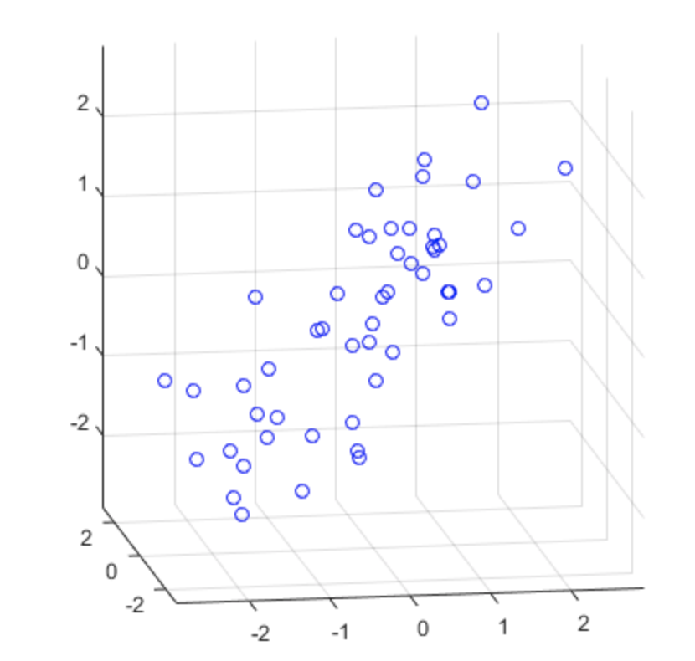
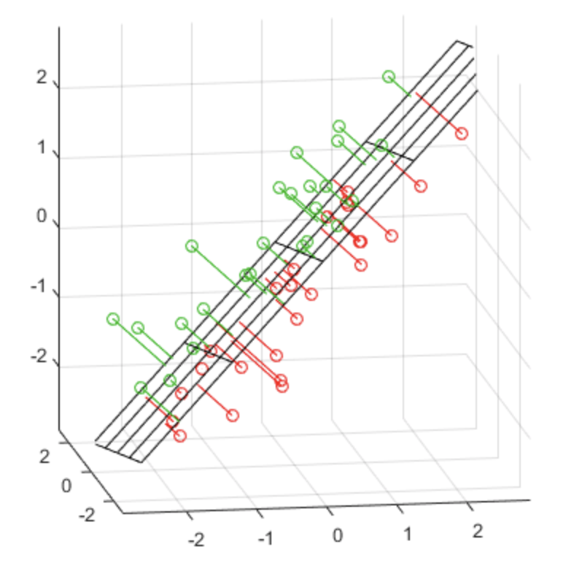
Unsupervised Learning Methods: PCA
In the Matlab description of PCA: PCA minimizes the perpendicular distances from the data to the fitted model. This is the linear case of what is known as Orthogonal Regression or Total Least Squares, and is appropriate when there is no natural distinction between predictor and response variables, or when all variables are measured with error. This is in contrast to the usual regression assumption that predictor variables are measured exactly, and only the response variable has an error component.
In this example data set from Matlab’s PCA examples, the PCA fits a plane to 3-d data

Slide 7
Unsupervised Learning Methods: PCA
This continues to find other linear combinations that are orthogonal to each other and are in the “directions” in multidimensional space corresponding to the eigenvalues of the covariance matrix. So the construction is to obtain p linear combinations y=B’X where B is a p x p matrix with kth column corresponding to the weights for the kth principal component. The optimal selection of weights is obtained from the eigenvalue decomposition 𝞢 = B 𝜦 B’ where 𝜦 is the diagonal matrix of eigenvalues. Then these principal components have mean zero, cov (y) = 𝜦 so the components of y are uncorrelated, cov (x, y) = B 𝜦 and corr(x_{i} , y_{i} ) = 𝛽_{j} (𝜆_{j})^{1/2} which are called the factor loadings and trace(𝞢 ) = trace(𝜦) so in this sense the j^{th} principal component “explains”
$\frac{λ_{j}}{\sum_{i=1}^{p}{λ_{i}}}$ of the total variance of the data.

Slide 8
Unsupervised Learning Methods: PCA
To apply this to data, we have a set of observations X which is a n x p matrix in which we assume the observations are independent replicates of the p-dimensional random vector x so the columns X_{i} of X correspond to observations of each measurement and assume we have subtracted the sample mean for each variable from these so that mean(X_{i}) = 0 and the sample covariance matrix is then S = X’ X /(n-1) and if the eigenvalue decomposition of S is B 𝜦 B’ then the sample principal components are Y = X B where Y is an n x p matrix containing the principal component “scores”(or values for the data) and B is a p x p orthonormal matrix containing the weights. Here var( Y_{j} ) = 𝜆_{j}
In practice, the singular value decomposition is used to obtain the eigenvalues and eigenvectors in B and 𝜦

Slide 9
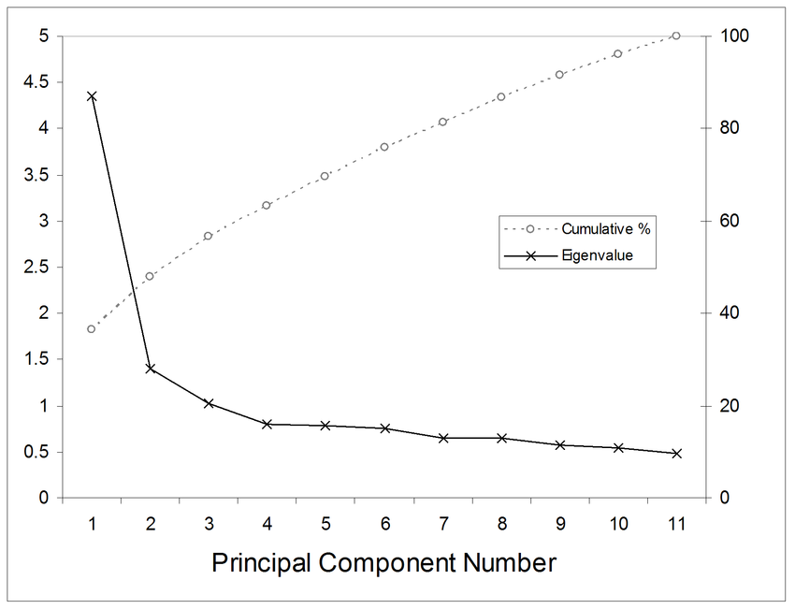
Unsupervised Learning Methods: PCA
In application, the question is how many PCA components should be included. No one answer to what PCA components to “cut-off at” is available but a standard approach is to make a “scree plot” of the eigenvalues (which are metrics for how much of the variance is explained by each PCA component) and ignore the components beyond that

Slide 10
Unsupervised Learning Methods: PCA
In application, a question is how to interpret the various PCA components. In general one should not expect that the PCA components should be readily interpretable without some understanding of the underlying measurements. Typically, you would look at the loadings (weights) assigned to the first components variable to see if there are some that are more highly weighted than others and try to interpret this limited combination of variables with highest weights. For example, in analysis of measurements on morphology and dry mass of various components of a carnivorous “pitcher” plant, the first PCA component assigns high weights to three measurements that together are a proxy for “size” of the pitcher (see Chapter 12 of Gotelli and Ellison, a Primer of Ecological Statistics)

Slide 11
Unsupervised Learning Methods: Factor Analysis
Factor analysis (FA) has the similar objective to PCA of reducing the dimensionality of the data but rather than creating new variables that are linear combinations of the measurements, FA considers each of the measurement variables to be linear combinations of some underlying factors. So in this sense, FA is PCA in reverse.
In practice, FA begins by doing a PCA, using scree plot or other method to choose a limited set of the PCA components, normalizing these PCA components (which are then called factors), and taking a linear combination of these factors to create a factor model. Similar to a PCA, a factor model is used to analyze how much of the variance of the data is explained by each factor.

Slide 12
Unsupervised Learning Methods: Multidimensional scaling
The objective of multidimensional scaling (MDS) is to represent measurements of similarity or dissimilarity between pairs of objects as distances between points in a low-dimensional space. So here you compute distances between points in a high dimensional space and attempt to find an arrangement of the objects in a lower dimensional space so that their distances approximate as close as possible the original distances.
Here let X be an N x p data matrix (N observations on p variables) from which a dissimilarity matrix D is calculated. If interested in the observations, D is an N x N matrix and if interested in the variables it is a p x p matrix.

Slide 13
Unsupervised Learning Methods: Principal Coordinates Analysis
PCA and FA are used for quantitative multivariate data and the objective is to preserve Euclidean distances between the observations. There are cases of data for which other distance metrics make more sense, for example in which the data are presence/absence matrices in which each row is a site or sample and the columns correspond to a species or taxon, and the matrix values are binary – 1 if present and 0 if not present. For these cases one approach for reducing the complexity of the data is Principal Coordinates Analysis (PCoA). PCA is actually a special case of PCoA when the data matrix corresponds to Euclidean distances. PCoA is also called metric multidimensional scaling.

Slide 14
Unsupervised Learning Methods: Correspondence Analysis
Correspondence analysis (CA)(also called reciprocal averaging or indirect gradient analysis) is typically used to analyse how species distributions change along environmental gradients (e.g. up a slope in a mountain). The typical assumption is that a species distribution is unimodal and somewhat normally distributed along the gradient. Then the objective is to choose new axes so that each in some sense maximizes the separation of species abundances along axes of “peaks”. It can be shown that CA is a special case of PCoA for which the distance metric is a chi-square measure ( e.g. observed – expected/(expected )^{1/2}

Slide 15
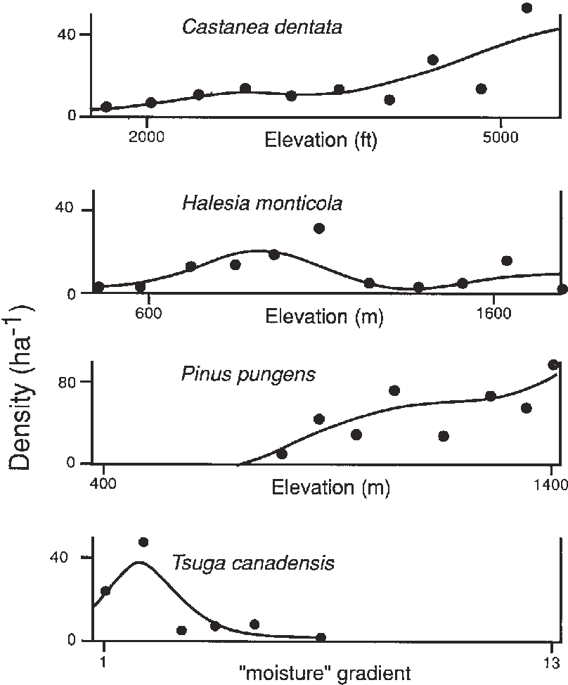
Unsupervised Learning Methods: Correspondence Analysis
Examples from classic papers by R. H. Whitaker of tree species distributions along gradients in the Great Smokies from Wilson et al., “Ecology or mythology? Are Whittaker's "gradient analysis" curves reliable evidence of continuity in vegetation?”

Slide 16
Unsupervised Learning Methods: Multidimensional scaling
The matrix D={d_{ij}} has elements that are dissimilarities between observations i and j that satisfy: (i) a non-negativity property so that d_{ij} ≥ 0 for all i and j with d_{ii} = 0 and (ii) a symmetry property so that d_{ij} = d_{ji} for all i and j.
If the d_{ij} satisfy the triangle inequality d_{ij} ≤ d_{ik} + d_{kj} for any k then it is a proper distance metric and the method is called Metric Multidimensional Scaling (MMDS). If the triangle inequality is not satisfied, the method is called Non-Metric Multidimensional Scaling(NMMDS). PCoA is MMDS.
The objective is to approximate the dissimilarities calculated from the data in p dimensional space by Euclidean distances calculated in q << p dimensional space and q is typically chosen to be 2 or 3.

Slide 17
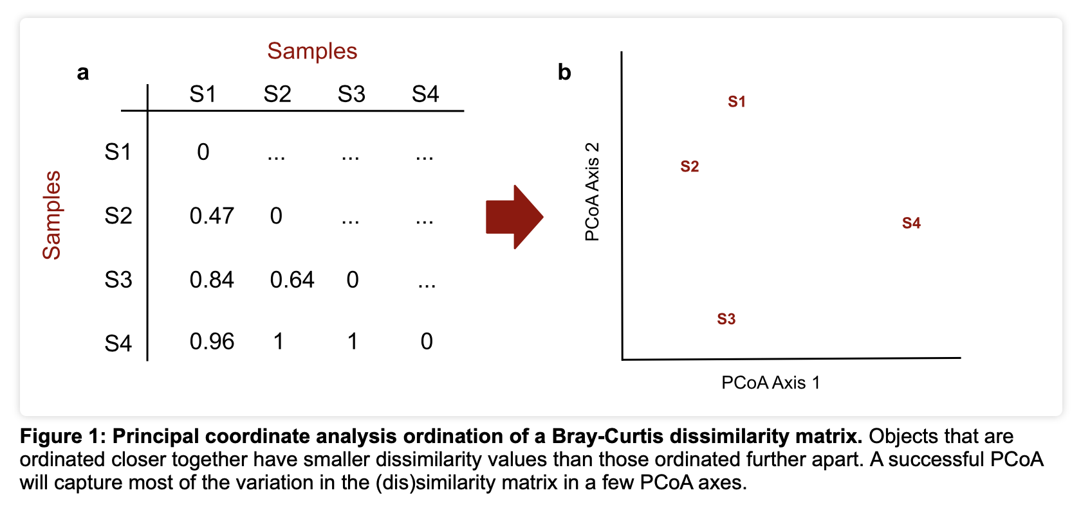
https://mb3is.megx.net/gustame/dissimilarity-based-methods/principal-coordinates-analysis
Here Bray-Curtis is a statistic that quantifies the dissimilarity in species composition between different sites based on counts of species at the sites so this statistics = 1 if there are no counts of the same species at the two sites.

Slide 18
Unsupervised Learning Methods: Multidimensional scaling
Let Z be a N x q matrix that contains the coordinates of the objects in the low dimensional space and assume that the “quality” of the approximation is determined through some loss function such as
$Stress\left(Z\right)=\sum_{i=1}^{N}{\sum_{j=i+1}^{N}{{(d_{ij}\left(Z\right)−d_{ij})}^{2}}}$
This is typically normalized by the sum of the squared estimates so what is used is
(${\frac{Stress(Z)}{\sum_{i<j}{d_{ij}^{2}}})}^{1/2}$
This can be modified to account for differences in variability among the components or measurement error by weighting the terms in the sum. These weights can reduce the impact of outliers in the low dimensional space.

Slide 19
Unsupervised Learning Methods: Multidimensional scaling
The solution process involves some iterative method to reposition the objects in the lower dimensional space (e.g. perturb their locations a bit), recalculate the stress and continue to iterate until the stress does not become smaller. A typical method would include a linear regression step in this process to regress the lower dimensional dissimilarities against those in the data and use this to get a linear estimator in the lower dimensional space and the stress is then calculated using the observed and regressed estimates in the lower dimensional space.
NMMDS goal is to place objects that are very different far apart in the low dimensional space while similar objects are placed close with only the rank ordering of the original dissimilarities preserved. The other ordination methods attempt to preserve the original distances.

