Slide 1
Math/EEB 589 - Mathematics of Machine Learning Methods in Ecology and Environmental Science Classification Example and General Approaches
Classification – an example of the calculations for a Bayesian decision process. This uses the data from the Fisher (1936) paper on three Iris species (I. setosa, I. versicolor, I. virginica). Remember that there are 4 measurements on each individual (sepal length, sepal width, petal length, petal width). Initially we will consider just one of these (sepal length), the extension to multiple measurements is considered briefly. The data are measurements on 50 individuals of each of the 3 species and are available online from https://gist.github.com/curran/a08a1080b88344b0c8a7.

Slide 2
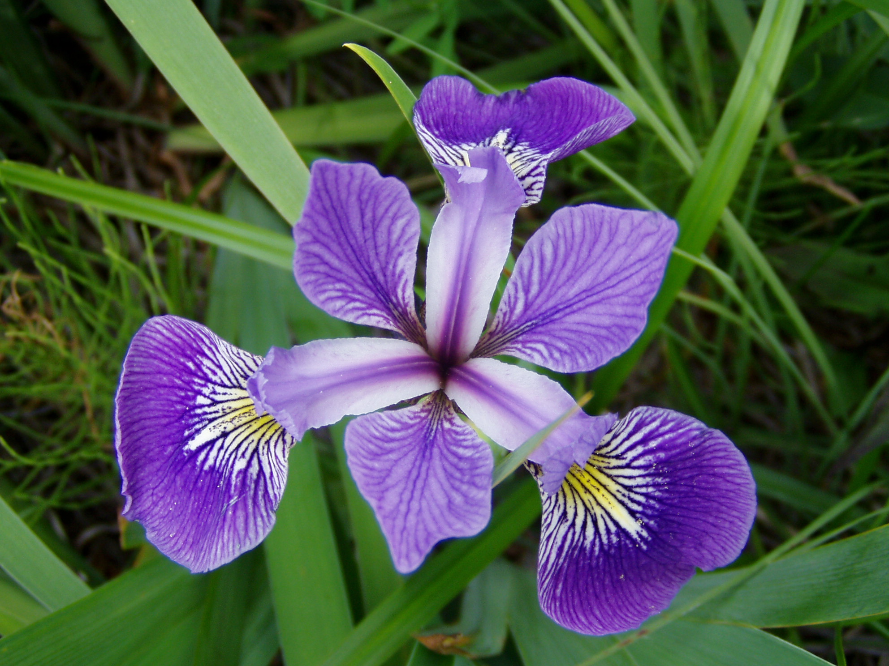
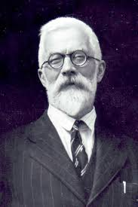
Iris versicolor
Iris setosa
Iris virginica

Slide 3
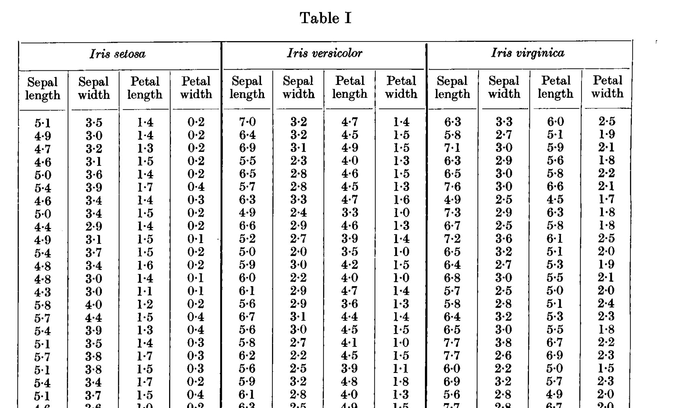
Fisher, R. A. 1936. The use of multiple measurements in taxonomic problems. Annals of Eugenics 7:179-188

Slide 4
So there is overlap in these two measurements across each species, but clearly some differentiation in measurement distribution

Slide 5
Remember from last week:
In the Bayesian perspective we view θ as chosen from a random variable θ with P_{θ}(X) giving the conditional distribution of X given θ = θ and
R(θ, 𝛿) = E[l(θ, 𝛿(X)) | θ = θ] is the expected loss if the decision rule is 𝛿 and θ = θ
Taking the expected loss across the distribution of θ gives the Bayes risk
r(𝛿) = E[R(θ, 𝛿)] = E[ E[l(θ, 𝛿(X)) | θ = θ]] = E[l(θ, 𝛿(X))]
If there is a rule 𝛿* which minimizes the Bayes risk it is called a Bayes rule
r(𝛿*) = min_{𝛿} r(𝛿)

Slide 6
The Bayesian example (1):
Here we think of parameter θ as specifying which species an individual is- 𝚯 = {1, 2, 3} where 1 = I. setosa, 2 = I. versicolor, 3 = I. virginica
We use the 0-1 loss function and let
p(x, θ) be the probability density for X for each θ and choose a prior probability density for the discrete values of θ
𝜋_{i}=P[θ = θi] where Σ 𝜋_{i} = 1
Then by Bayes the posterior probability is
$P[θ=θ_{i}$ | X = x] $=\frac{π_{i}p(x,θ_{i})}{\sum_{j}{π_{j}p(x,θ_{j})}}$
We saw an optimal decision rule 𝛿*(x) (Bayes rule) would be choosing
r(𝛿*(x)|x) = min _{0≦j≦p} r(a_{i}|x)
And this means maximizing the posterior probability
So the optimal choice of group i to assign a new observation to is the i which maximizes this for the observed value x.
$P[θ=θ_{i}$ | X = x] $=\frac{π_{i}p(x,θ_{i})}{\sum_{j}{π_{j}p(x,θ_{j})}}$

Slide 7
The Bayesian example (2):
So we need to choose a prior distribution 𝜋_{i}=P[θ = θ_{i}] on the parameter θ which means estimating the overall probability initially, when a randomly chosen individual is measured, that the individual is a member of each of these species. Without any information on the relative abundance of each species in the area, we use the non-informative prior
𝜋_{I} = 1/3 for i = 1, 2, 3
Next, we need to choose the probability distribution for the measurements (sepal length) for each of the 3 species to specify p(x, θ_{i}) for i = 1, 2, 3
So let’s look at the data for each of the species for this measurement.

Slide 8
Based on these data, what do you expect a classifier to do for measurements of just sepal length?

Slide 9
The Bayesian example (3):
What options do you suggest from the data for p(x, θ_{i}) ?
We will choose a very simple option to illustrate the calculations. We take the distribution to be uniform with mean that of the sample distribution for each species and uniform over the interval [mean – ½ range, mean + ½ range]
So from the data we get
p(x, 1) = .666 on [4.26,5.76]
p(x, 2) = .476 on [4.89,6.99]
p(x, 3) = .333 on [5.09,8.09]

Slide 11
The Bayesian example (4):
So for any measured value of sepal length we calculate the posterior probability for each i and the Bayes decision rule is to choose the θ which is the largest of the 3 values
$P[θ=θ_{i}$ | X = x] $=\frac{π_{i}p(x,θ_{i})}{\sum_{j}{π_{j}p(x,θ_{j})}}=Pi(x)$
Here since 𝜋_{I} = 1/3 this simply reduces to comparing the values of
$$\frac{p(x,i)}{\sum_{j}{p(x,j)}}$$
And choosing the one that is largest gives us the classified species for the measured individual.

Slide 12
The Bayesian example (5):
Here for example the 3 values for x= 5.2 are P₁(5.2) = .45, P₂(5.2) = .32, P₃(5.2) = .23 so if we have a plant with sepal length 5.2, it would classified as species 1 (I. setosa). For x= 6.0 the values are P₁(6.0) = 0, P₂(6.0) = .59, P₃(6.0) = .23 so it would be classified as species 2 (I. versicolor). For x = 6.6 the values are P₁(6.0) = 0, P₂(6.0) = .59, P₃(6.0) = .41 so it would be classified as species 2 (I. versicolor). For x = 7.2 we have P₁(7.2) = 0, P₂(7.2) = .0, P₃(7.2) = 1 so it would be classified as species 3 (I. virginica).
Note that these results align somewhat with expectations by choosing values near the means of the species prior distributions.

Slide 13
Graphs of the decision rule component functions – choose the species which is the maximum of these for any value of sepal length

Slide 14
The Bayesian example (6):
How can we improve this decision process?
Obtain data on species abundance in the region to choose a more informative prior
Choose a probability distribution of sepal length for each species that is more aligned with the data – perhaps a triangular distribution or possibly a normal distribution
Use a resampling procedure based on the actual data to estimate the probabilities in the Bayes risk calculation rather than constraining this to a particular parametric distribution
Use all of the measurements on individuals rather than just sepal length

Slide 15
The Bayesian example (7):
How do we use all of the data in this decision framework?
We need to choose a multivariate distribution for p(x, i) where x is the vector of measurements. In the simplest case, we’d simply assume that the random variables for the measurements are independent for each species (perhaps a poor choice because we expect correlations between these), choose a distribution (like the uniform one we used) for each measurement, and the p(x, i) is then just the product $\prod_{j=1,4}{p(xj,i)}$ but it is more appropriate to choose a multivariate normal distribution perhaps that would account for correlations between measurements. Once a p(x, i) is chosen, the procedure is the same as above for discrete classification – maximize the posterior distribution.

Slide 16
General structure of classification as a statistical decision problem (1)
Classification is also known as pattern recognition in some areas and uses supervised learning now that computational capacity is available.
Suppose there are data on N objects, each characterized by a “feature” vector x with p elements (in ℛ^{p} or a discrete space). Each object is assigned to one of K prespecified classes for which a decision rule 𝒞(x_{i}) assigns object i with feature vector x_{i} to class c_{k} k=1,…., K
Let C be the random variable which assigns a class to a random feature vector X with a prior probability distribution that doesn’t depend on X so that
𝜋_{i}=P[C = i] i = 1, …,K where Σ 𝜋_{i} = 1

Slide 17
General structure of classification as a statistical decision problem (2)
Now let 𝒞(x): ℛ^{p}→ {1, 2, …, K, D} be a decision rule with D denoting an “in doubt” option. The loss function is taken to be 0-1 so that l(i,k) = 1 if the rule assigns the object to class i but the true class is k, and l(i,i) = 0 For the in doubt option assume l(D,i) = d for all classes i = 1, …, K. Also assume that all objects in class i have the conditional probability distribution for the feature vector given by p_{i}(x)
Then the risk function for the classifier rule 𝒞 is the expected loss as a function of the unknown class i
r(𝒞, C=k) = E_{x}[L(𝒞,k) | C=k] =
$\sum_{i=1}^{K}{l\left(i,k\right)P\left[𝒞=i | C=k\right]+l\left(D,k\right)P[𝒞=D|C=k]}$
Here the expectation is taken with respect to the distribution of the feature vector x

Slide 18
General structure of classification as a statistical decision problem (3)
Then the total risk is the total expected loss viewing both the class C and the feature vector X as random
r(𝒞) = E_{k,x}[r(𝒞, C) ] =
$\sum_{k=1}^{K}{π_{k}P\left[𝒞≠k | C=k\right]+d \sum_{k=1}^{K}{π_{k}P\left[𝒞=D | C=k\right]}]}$
This gives the total misclassification probability plus d times the overall doubt probability. The challenge is then to find a classifier rule 𝒞 which minimizes this total risk.

Slide 19
General structure of classification as a statistical decision problem (4)
If we know both the prior probability distribution {𝜋_{i} } and the posterior distribution of class k given feature vector x
p(k|x) = P[C = k | X = x ]
$$=\frac{π_{k}p(k|x)}{\sum_{j}{π_{j}p(j|x)}}$$
Then it is possible to prove (using an argument similar to that we discussed for the example of a classifier for a new object earlier) that the classifier that minimizes the total risk for the 0-1 loss function is
𝒞(x) = k if p(k|x) = max _{1≦j≦K} p(j|x) and exceeds 1-d
= D if each p(k|x) ≦ 1-d
And this reduces for the case of no in-doubt option to the previous example.

