Slide 1
Math/EEB 589 - Mathematics of Machine Learning Methods in Ecology and Environmental Science
Classification and Machine Learning
Let’s start by looking at the classification problem again that uses the Iris data from Fisher (1936) again, using a different parameterized distribution function for the distribution of sepal length – looking again at the calculations for a Bayesian decision process.

Slide 3
Graphs of the distribution functions for sepal length using a uniform and a triangle distribution

Slide 4
The Bayesian risk calculation for uniform and triangle distributions:
Sepal length Uniform (P1, P2 , P3) Triangle (P1, P2 ,P3) 5.2 .45* .32 .23 .75* .22 .04
6.0 0 .59* .23 0 .69* .31
6.6 0 .59* .41 0 .35 .65*
7.2 0 0 1* 0 0 1*
The * indicates the largest Bayes risk and if it is P1 the classifier indicates the individual is classified as Iris setosa, if it is P2 the classifier indicates the individual is classified as Iris versicolor, if it is P3 the classifier indicates the individual is classified as Iris virginica

Slide 5
Graphs of the decision rule component functions – choose the species which is the maximum of these for any value of sepal length – left figure uses uniform distribution for sepal length and right figure uses a triangle distribution

Slide 6
Take-away from this:
The performance of the classifier depends upon the choice of the distribution function of the feature measurements for each class in the set of possible classes.
This is an example of supervised learning because we use a training set (in this case the entire data set available) to determine a classifier for measurements on a new object to place it in one of a specified number of classes.
Utilizing all the data available for multiple measurements on each object requires a multivariate distribution function
This data set doesn’t allow us to say much about estimating a prior distribution for the classes because the training set had equal numbers of each class (species)

Slide 7
General structure of classification as a statistical decision problem (1)
Classification is also known as pattern recognition in some areas and uses supervised learning now that computational capacity is available.
Suppose there are data on N objects, each characterized by a “feature” vector x with p elements (in ℛ^{p} or a discrete space). Each object is assigned to one of K prespecified classes for which a decision rule 𝒞(x_{i}) assigns object i with feature vector x_{i} to class c_{k} k=1,…., K
Let C be the random variable which assigns a class to a random feature vector X with a prior probability distribution that doesn’t depend on X so that
𝜋_{i}=P[C = i] i = 1, …,K where Σ 𝜋_{i} = 1

Slide 8
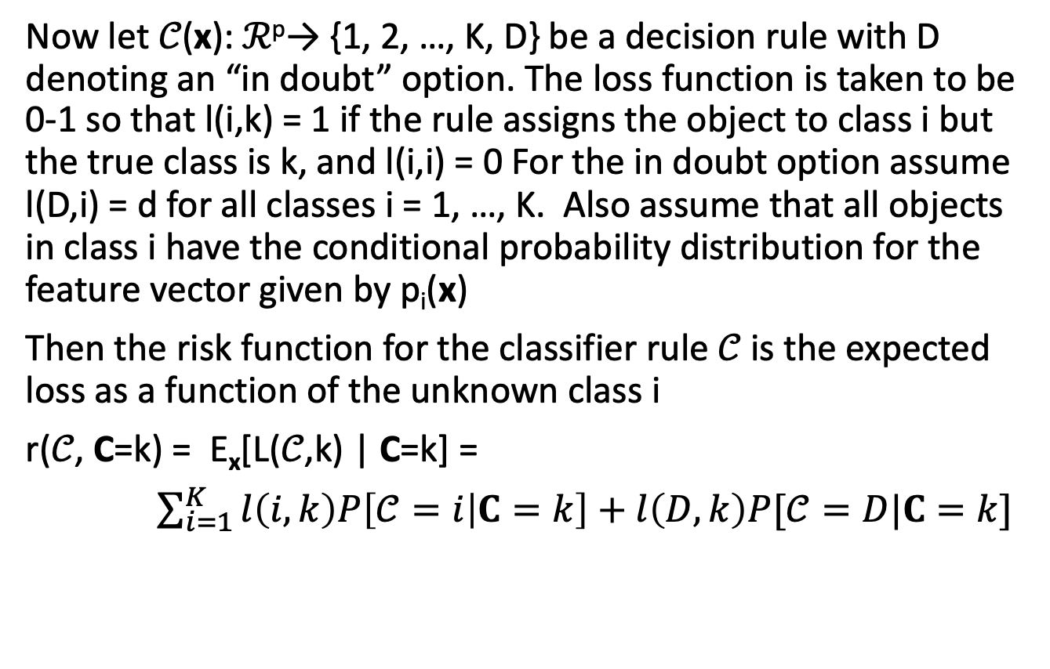
General structure of classification as a statistical decision problem (2)
Now let 𝒞(x): ℛ^{p}→ {1, 2, …, K, D} be a decision rule with D denoting an “in doubt” option. The loss function is taken to be 0-1 so that l(i,k) = 1 if the rule assigns the object to class i but the true class is k, and l(i,i) = 0 For the in doubt option assume l(D,i) = d for all classes i = 1, …, K. Also assume that all objects in class i have the conditional probability distribution for the feature vector given by p_{i}(x)
Then the risk function for the classifier rule 𝒞 is the expected loss as a function of the unknown class i
r(𝒞, C=k) = E_{x}[L(𝒞,k) | C=k] =
$\sum_{i=1}^{K}{l\left(i,k\right)P\left[𝒞=i | C=k\right]+l\left(D,k\right)P[𝒞=D|C=k]}$
Here the expectation is taken with respect to the distribution of the feature vector x

Slide 9
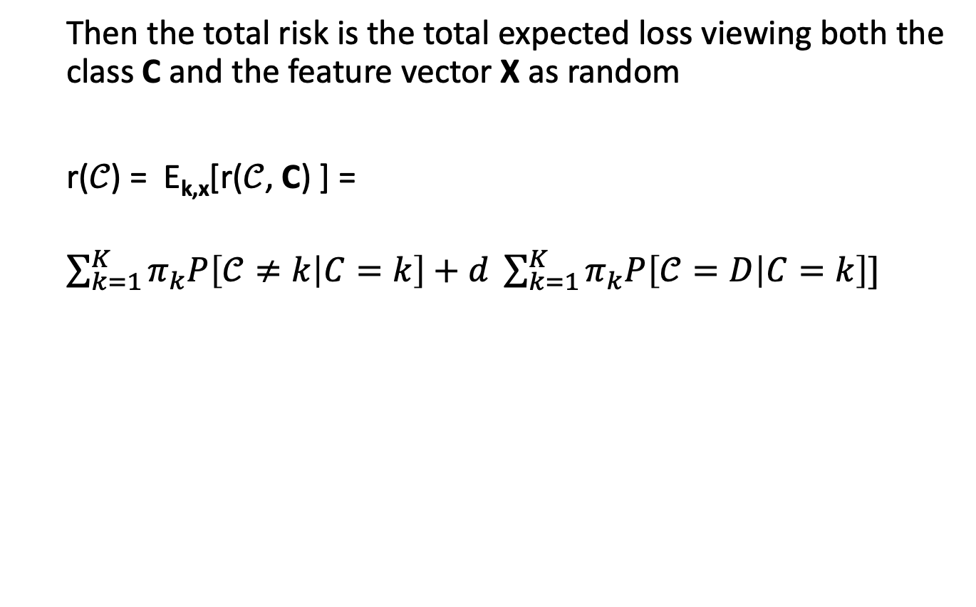
General structure of classification as a statistical decision problem (3)
Then the total risk is the total expected loss viewing both the class C and the feature vector X as random
r(𝒞) = E_{k,x}[r(𝒞, C) ] =
$\sum_{k=1}^{K}{π_{k}P\left[𝒞≠k | C=k\right]+d \sum_{k=1}^{K}{π_{k}P\left[𝒞=D | C=k\right]}]}$
This gives the total misclassification probability plus d times the overall doubt probability. The challenge is then to find a classifier rule 𝒞 which minimizes this total risk.

Slide 10
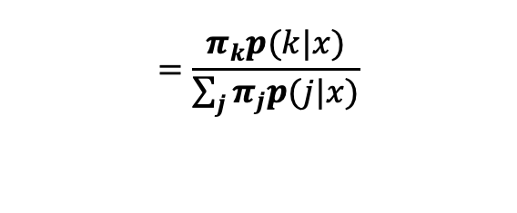
General structure of classification as a statistical decision problem (4)
If we know both the prior probability distribution {𝜋_{i} } and the posterior distribution of class k given feature vector x
p(k|x) = P[C = k | X = x ]
$$=\frac{π_{k}p(k|x)}{\sum_{j}{π_{j}p(j|x)}}$$
Then it is possible to prove (using an argument similar to that we discussed for the example of a classifier for a new object earlier) that the classifier that minimizes the total risk for the 0-1 loss function is
𝒞(x) = k if p(k|x) = max _{1≦j≦K} p(j|x) and exceeds 1-d
= D if each p(k|x) ≦ 1-d
And this reduces for the case of no in-doubt option to the previous example.

Slide 11
General structure of classification as a statistical decision problem (5) – connection to learning
The above process assumes that there is perfect knowledge of both the prior across all classes and of the conditional distributions of features for each class. In practice what is done is to use a training set 𝒯 ={c_{i},x_{i}} i=1, …, N where c_{i} is the “correct” classification assigned to a feature vector x_{i} and this set is used to “learn” a classification rule C(x|𝒯) by estimating the posterior probability of choosing class k given the feature vector x and the training set 𝒯, p(k|x, 𝒯). The Iris data used by Fisher is an example of a training set.

Slide 12
General structure of classification as a statistical decision problem (6) – connection to learning
A consistent estimator of the prior distribution 𝜋_{i} is obtained by counting the number of occurrences of class i in the training set and dividing by the total number of elements of the training set 𝒯. Remember a consistent estimator for a parameter of a probability distribution is an estimator (a function of the observations) that converges with probability one to the true value of the parameter as the sample size increases (this is the Strong Law of Large Numbers assuming the observations are independent).

Slide 13
General structure of classification as a statistical decision problem (7) – connection to learning
There are 2 main approaches to establishing the learning procedure (e.g. updating in a Bayesian manner) for the classification rule C(x|𝒯):
Parametric – the class conditional distributions
p(k|x, 𝒯) are specified in some class of distributions (e.g. multivariate normal) and the goal is to learn (update) the parameters of the distribution from the training set
(ii) Non-parametric – the the class conditional distributions p(k|x, 𝒯) are learned from the training data (using for example some resampling method).

Slide 14
How good is a classifier? Assessing performance of a classification procedure.
The misclassification error rate is the probability of misclassifying a new randomly sampled object
The apparent error rate is the probability of error when classifying either an observation from the training set or from an independent set.
The training set error rate is expected to be biased down (e.g. lower than that for an independent set).
Cross-validation is a method to more effectively use all data (an independent set as well as training set) and partitions randomly the training set 𝒯 into M parts, using M-1 of these together as the training set and using the remaining part as a test set, and repeating M times, each time calculating the error rate of the test set (number of incorrect assignments/ size of the test set) and then averaging the error rate across all M sets. (in this case the error rates are unbiased. Using M= total number of observations gives the “leave-one-out” cross validation.

Slide 15
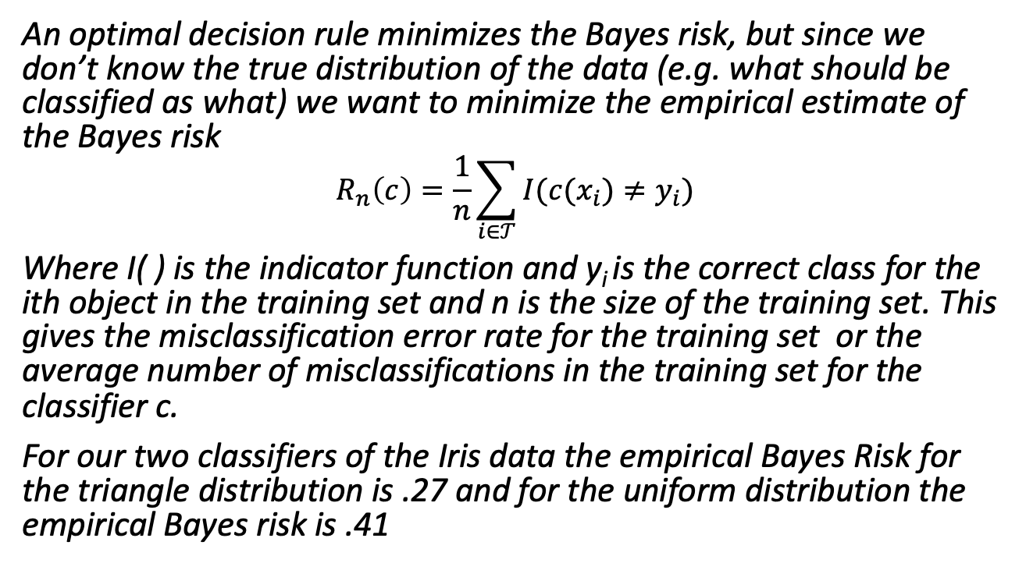
How good is a classifier? Connection to statistical decision theory (1).
An optimal decision rule minimizes the Bayes risk, but since we don’t know the true distribution of the data (e.g. what should be classified as what) we want to minimize the empirical estimate of the Bayes risk
$$R_{n}\left(c\right)=\frac{1}{n}\sum_{i∈𝒯}{I(c(x_{i})≠y_{i})}$$
Where I( ) is the indicator function and y_{i} is the correct class for the ith object in the training set and n is the size of the training set. This gives the misclassification error rate for the training set or the average number of misclassifications in the training set for the classifier c.
For our two classifiers of the Iris data the empirical Bayes Risk for the triangle distribution is .27 and for the uniform distribution the empirical Bayes risk is .41

Slide 16
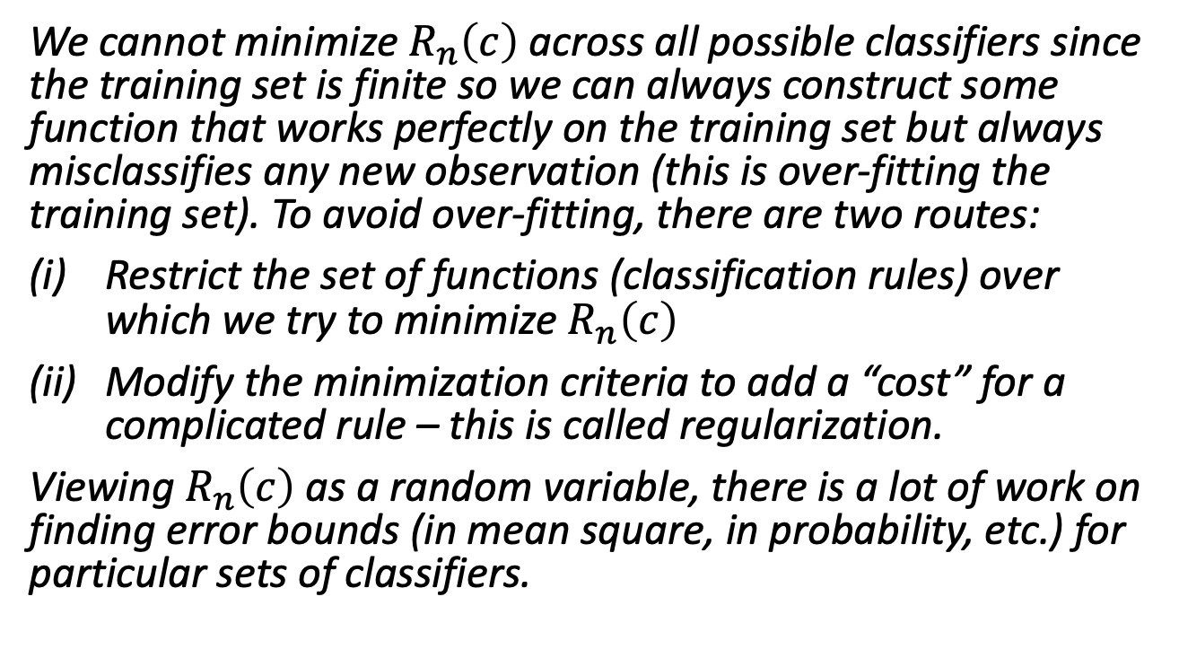
How good is a classifier? Connection to statistical decision theory (2).
We cannot minimize $R_{n}\left(c\right)$ across all possible classifiers since the training set is finite so we can always construct some function that works perfectly on the training set but always misclassifies any new observation (this is over-fitting the training set). To avoid over-fitting, there are two routes:
Restrict the set of functions (classification rules) over which we try to minimize $R_{n}\left(c\right)$
Modify the minimization criteria to add a “cost” for a complicated rule – this is called regularization.
Viewing $R_{n}\left(c\right)$ as a random variable, there is a lot of work on finding error bounds (in mean square, in probability, etc.) for particular sets of classifiers.

Slide 17
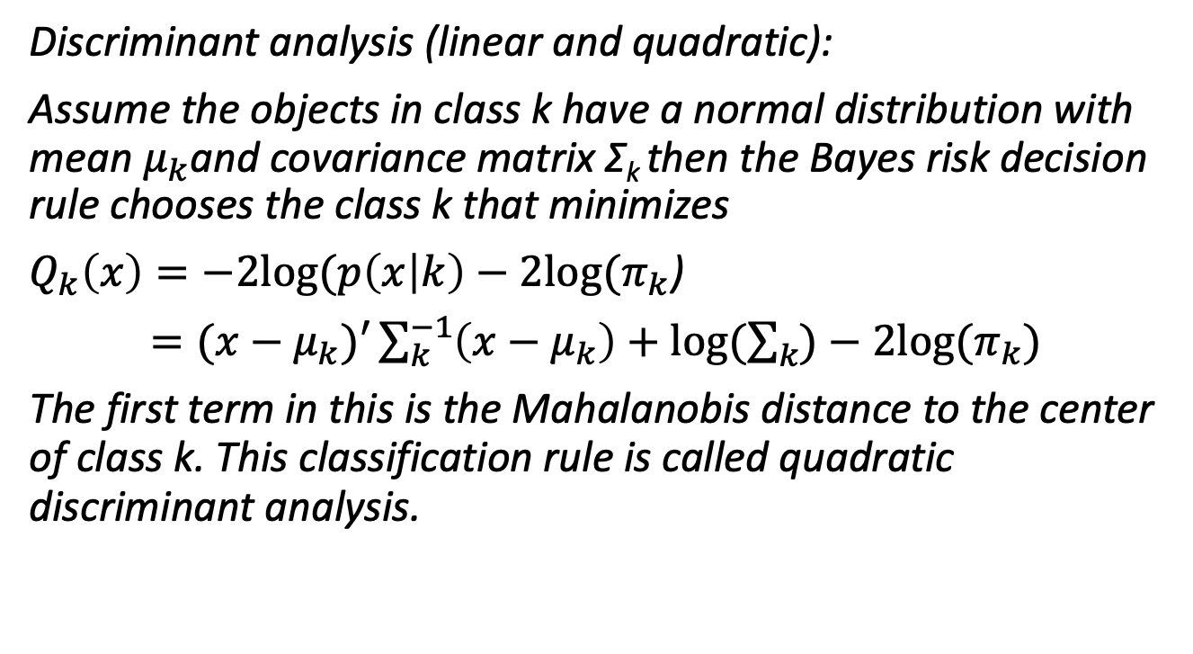
Some classification methods: Probability models
Discriminant analysis (linear and quadratic):
Assume the objects in class k have a normal distribution with mean $μ_{k}$and covariance matrix Σ_{k} then the Bayes risk decision rule chooses the class k that minimizes
$Q_{k}\left(x\right)=−2log⁡(p\left(x | k\right)−2log⁡(π_{k}$)
$=(x−μ_{k})′\sum_{k}^{−1}{\left(x−μ_{k}\right)+log⁡(\sum_{k}{)−2log⁡(π_{k}}})$
The first term in this is the Mahalanobis distance to the center of class k. This classification rule is called quadratic discriminant analysis.

Slide 18
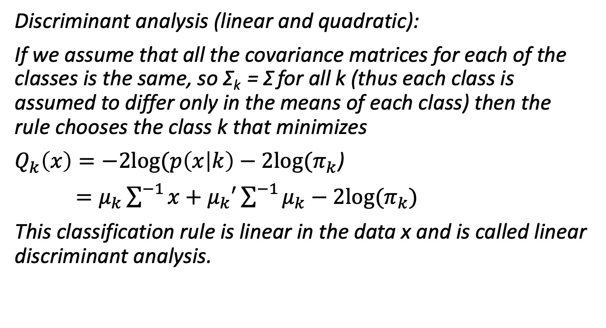
Some classification methods: Probability models
Discriminant analysis (linear and quadratic):
If we assume that all the covariance matrices for each of the classes is the same, so Σ_{k} = Σ for all k (thus each class is assumed to differ only in the means of each class) then the rule chooses the class k that minimizes
$Q_{k}\left(x\right)=−2log⁡(p\left(x | k\right)−2log⁡(π_{k}$)
$=μ_{k}\sum^{−1}{x+μ_{k}′\sum^{−1}{μ_{k}}}−2log⁡(π_{k})$
This classification rule is linear in the data x and is called linear discriminant analysis.

Slide 19
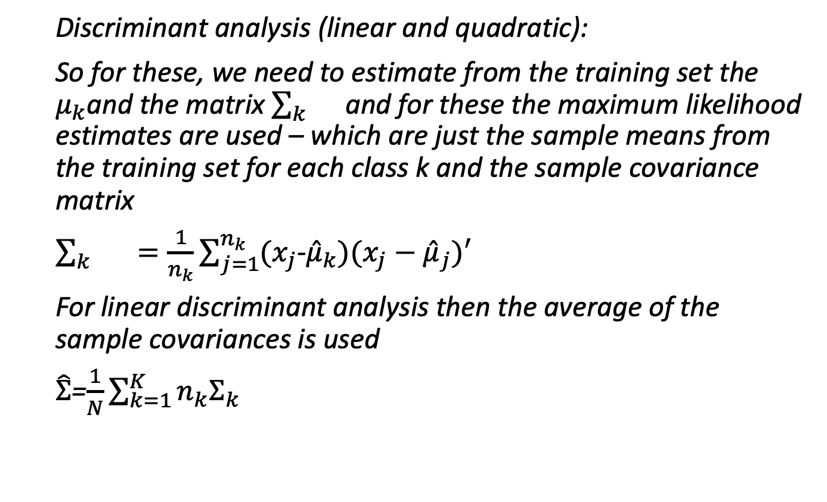
Some classification methods: Probability models
Discriminant analysis (linear and quadratic):
So for these, we need to estimate from the training set the $μ_{k}$and the matrix $\sum_{k}{}$ and for these the maximum likelihood estimates are used – which are just the sample means from the training set for each class k and the sample covariance matrix
$\sum_{k}{}=\frac{1}{n_{k}}\sum_{j=1}^{n_{k}}{(x_{j}}$-${\hat{μ}}_{k})(x_{j}−{\hat{μ}}_{j})′$
For linear discriminant analysis then the average of the sample covariances is used
$\hat{Σ}$=$\frac{1}{N}\sum_{k=1}^{K}{n_{k}Σ_{k}}$

Slide 20
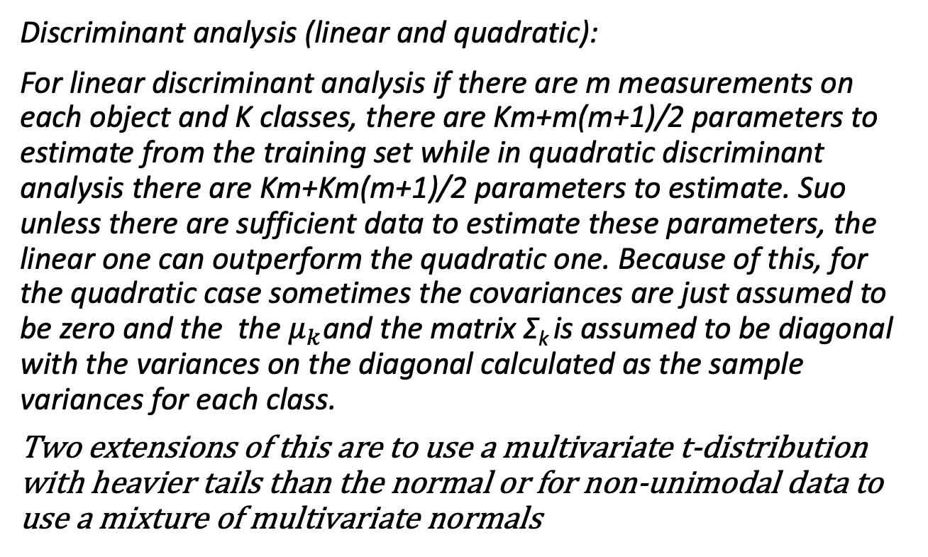
Some classification methods: Probability models
Discriminant analysis (linear and quadratic):
For linear discriminant analysis if there are m measurements on each object and K classes, there are Km+m(m+1)/2 parameters to estimate from the training set while in quadratic discriminant analysis there are Km+Km(m+1)/2 parameters to estimate. Suo unless there are sufficient data to estimate these parameters, the linear one can outperform the quadratic one. Because of this, for the quadratic case sometimes the covariances are just assumed to be zero and the the $μ_{k}$and the matrix Σ_{k} is assumed to be diagonal with the variances on the diagonal calculated as the sample variances for each class.
Two extensions of this are to use a multivariate t-distribution with heavier tails than the normal or for non-unimodal data to use a mixture of multivariate normals

